Slide 1
What is the Compliance Audit?
Compliance Audit is detailed review of organization’s loyalty towards uphold of the rules and regulations which includes statutory and internal rules, regulations, policies and procedures framed by Government, local authorities and organization’s management by evaluating compliance procedure, security policies, user access control, risk management procedure and entity’s policy, procedure and processes. This is a type of audit service that focuses on whether the entity complying with statutory laws, local laws, internal rules and decisions of the organization as applicable on it or not.

Slide 2
Purpose
The purpose behind conducting a compliance audit is to assess the organization’s compliance program is effective or not and bringing out the non-compliance in front of management and Government/Tax authorities.
Objectives
To ensure a company meets the guidelines from Government regulatory agencies and it’s own internal policies.
To improve the organization’s efficiency in the business environment.
To uphold the faith of stakeholders.
To comply with the various other laws like Environmental laws, Consumer safety laws, etc.
To ensure standard operating procedure has been followed throughout the organization.

Slide 3
Compliance Audit Process
The process from the perspective of each of them are:
#1 – For Organization
Identify the need and extent of the audit.
Select the Auditor
/ team to perform, verify the Auditor/Team meet the qualification criteria for conducting an audit.
Co-ordinate with the auditor with all requirements and information asked for.
#2 – For Auditor
List out the Statutory Laws applicable to the entity.
Obtain a list of the company’s internal policies, procedures, and decisions for compliance.
Engage the experienced team members for the CA assignment.
Segregate the different areas of the organization to audit. Prioritize the areas of examination.
Obtain a list of laws applicable to entity and their compliance status.
Plan the audit, nature, extent, timing, and procedures to be performed. Prepare Checklist.
Review the procedure of the organization on compliance with laws and internal policies and communication processes regarding the same.
Review the Internal Auditor
Report, Tax/Statutory Audit reports
, and previous year’s report of a compliance audit.
Conduct the audit to discuss non-compliance with the management of the organization.
Suggest ways to improve.
American Institute of Certified Public Accountants that apply to service providers that hold or process Prepare audit reports and submit to the appointing authority/ Management. Ensure that all information is arranged in an easily understood manner.

Slide 4
Types
SOC 2: This defined by the data in the cloud.
ISO 27001 (27000 Series): It applies to companies/ Organizations that manage the security of assets, such as employee or third-party data, financial information, and intellectual property.
General Data Protection Regulation: It applies to companies/ organizations that process the data of European citizens.
Sarbanes- Oxley: It applies to public companies which issue IPO is required to get compliance audit of financial and IT related laws.
PCI Compliance Standards: It is applicable to credit card and payment industries like merchants, financial institutions, and payment solution providers.
HIPAA Compliance Regulation: It applies to the health care industry, like hospitals and medical service providers.
FINRA: It applies to the investment industry, specifically those who register as stockbroker or broker-dealer firms, protecting investors against potential fraud on U.S Securities and Exchange Commission.
FISMA: It applies to US Governmental organizations.
Obligatory Compliance Audit: Any Organization that wants to conduct an audit can do so by appointing any person who might be an internal auditor or any other person who meets the qualification criteria.

Slide 5
Who does the Compliance Audit Perform?
The company’s internal auditor may conduct it.
Sometimes it could be performed by external auditors depends upon the choice of management.
For companies who require a compulsory compliance audit – this is conducted by the person mentioned in that law.
For companies that perform obligatorily, the person who meets the qualification criteria can perform the audit.
Importance
Identify weaknesses in the regulatory compliance process.
Help to reduce risk.
Keep the faith of stakeholders.
Ensures that all laws have been followed.
Non-compliance can be identified and corrected.

Slide 6
Difference Between Compliance Audit and Financial Audit
A financial audit is an examination of financial statements, and a compliance audit is the examination of laws and procedures complied.
Chartered Accountant does financial Audit, and Compliance audit may or may not done by CA.
Financial audit deals with financial data, while compliance audit deals with statutory and regulatory compliance.
An Independent auditor does a financial audit while a compliance audit is done by any person who meets qualification criteria may or may not independent.
Benefits
It ensures proper compliance with statutory regulations and laws.
It reduces the legal risk of the company.
With this position, the trust of the general public in the company increases.
Ensures Transparent Reporting;
It helps in avoiding the future cost of the company that may apply to it.
It ensures proper management.

Slide 7
what if an organization does not comply with compliance laws
What is Non Compliance?
Regulatory non-compliance occurs when an organisation fails to comply with the policies, standards, regulations or laws relevant to its operations.
Examples of non compliance include:
Failure to wear personal protective equipment (PPE)
Insufficient administration of operations
Failure to obtain proper certifications/illegal operations
Failure to follow operation procedures
Failure to report to relevant authorities

Slide 8
what if an organization does not comply with compliance laws
Why is Statutory Compliance crucial?
The following are the fundamental reasons why an organization shouldn’t take statutory compliance lightly.
1. Required by Law – All registered companies are mandatorily obligated by the law to follow statutory regulations and comply with them.
2. Audits – Non-compliance also invites unnecessary inspection and audits, leading to waste of time and money.
3. Financial Penalties – Failing to adhere to statutory compliance will lead to imposition of heavy fines and indirect losses to organizations.
4. Imprisonment – Severe cases of non-compliance may result in imprisonment of the organization’s CEO/Directors/Board members.
5. Brand Value and Market Reputation – Payment of fines and imprisonment can destroy a company’s brand name in the market it thrives in.
6. Forced Shutdown of the Company – In cases that exhibit perilous non-compliance, authorities can even order companies to cease operations.

Slide 9
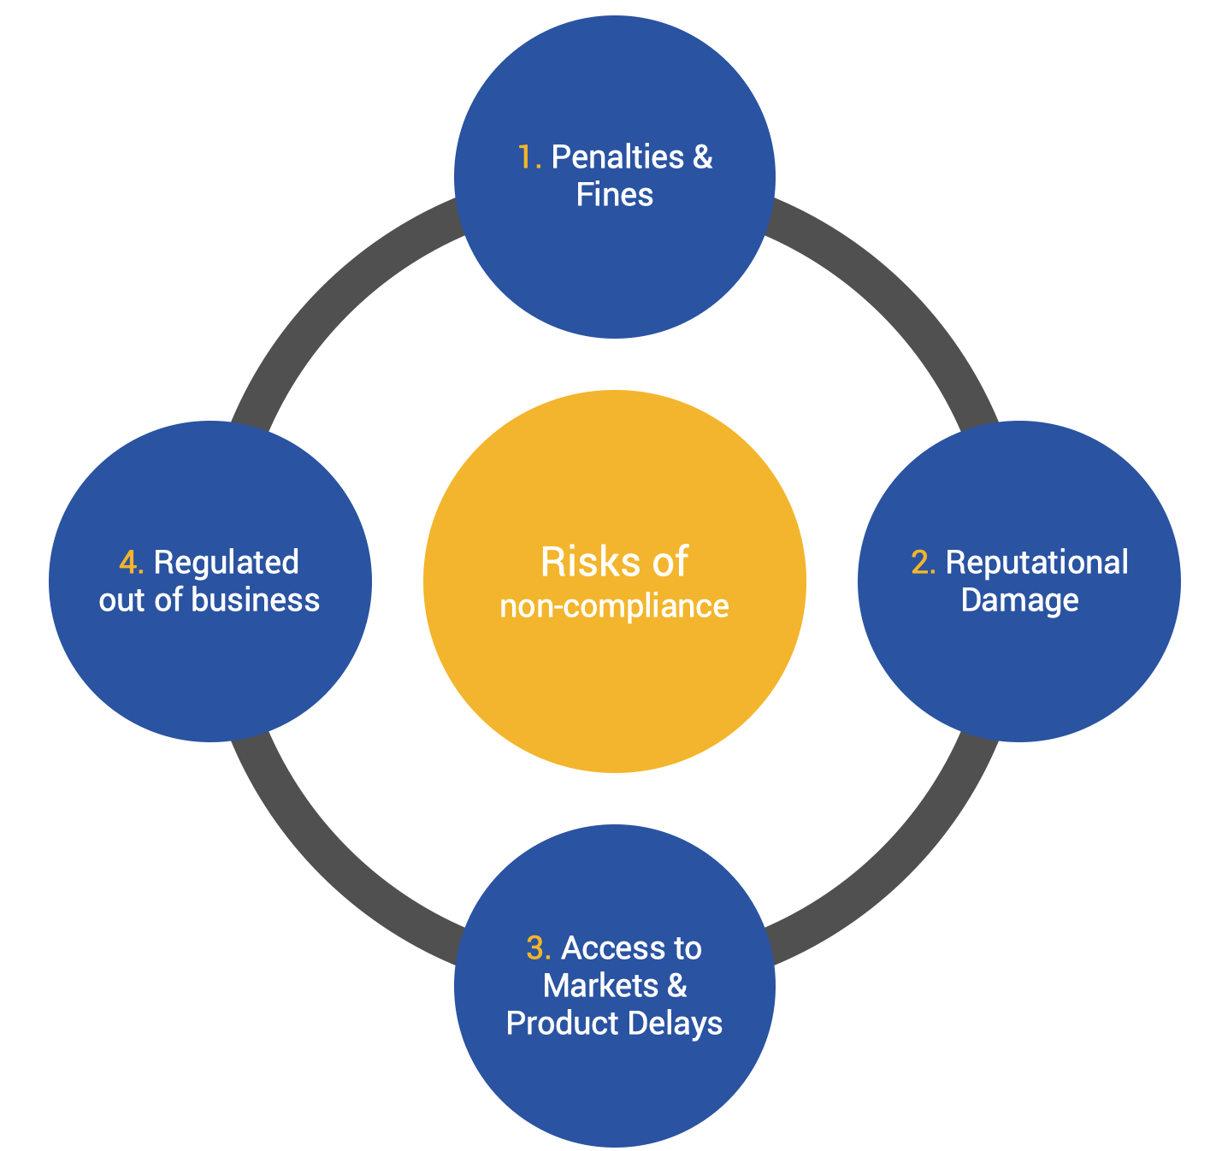
what is an organization is not comply with compliance laws

Slide 10
what does your organization do to be in compliance

